Slide 1
Hand Written Digit Recognition Using CNN
Presented By:
Sabahat Ijaz (P16-6055)
Laiba Gul (P16-6117)

Slide 2
Why CNN
The performance of digit recognition largely depends on the feature extraction approach and the classification/learning scheme. For feature extraction of digit recognition, various approaches have been proposed. Many experiments have shown that the Convolutional Neural network feature is one of the most efficient features for hand-written digit recognition.
Neural Network seems to be better than other techniques used for recognition.

Slide 3
Libraries Used
Numpy
Keras
Matplotlib

Slide 4
Dataset
MNIST dataset
60000 training samples
10000 testing samples

Slide 5
Variables
Batch size=200
Epochs=10
Num_classes=10

Slide 6
Layers
Input Layer contains 784=28*28 neurons
Convolutional layer with 32 feature maps of size 5x5
Pooling layer taking the max over 2x2 patches
Convolutional layer with 16 feature maps of size 3x3
Pooling layer taking the max over 2x2 patches
Dropout layer with probability of 20%
Flatten layer
Fully connected layer with 128 neurons and rectifier activation
Fully connected layer with 50 neurons and rectifier activation
Output layer

Slide 7
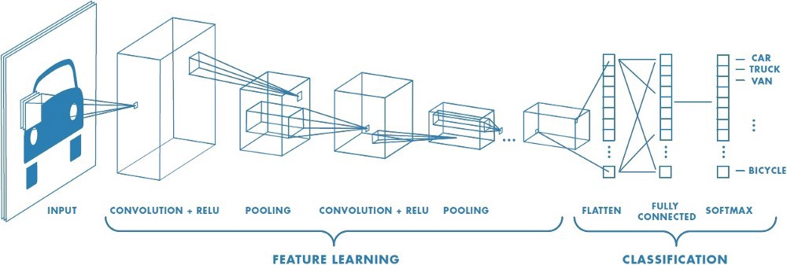
CNN

Slide 8
Result epoch 1-5
99.15 % with training in 10 Epochs
Epoch 1/10
60000/60000 [==============================] - 51s 846us/step - loss: 0.2429 - accuracy: 0.9296 - val_loss: 0.0697 - val_accuracy: 0.9791
Epoch 2/10
60000/60000 [==============================] - 53s 882us/step - loss: 0.0701 - accuracy: 0.9792 - val_loss: 0.0452 - val_accuracy: 0.9853
Epoch 3/10
60000/60000 [==============================] - 50s 840us/step - loss: 0.0484 - accuracy: 0.9853 - val_loss: 0.0428 - val_accuracy: 0.9847
Epoch 4/10
60000/60000 [==============================] - 52s 874us/step - loss: 0.0369 - accuracy: 0.9884 - val_loss: 0.0357 - val_accuracy: 0.9883
Epoch 5/10
60000/60000 [==============================] - 48s 808us/step - loss: 0.0279 - accuracy: 0.9916 - val_loss: 0.0336 - val_accuracy: 0.9888

Slide 9
Result epoch 6-10
Epoch 6/10
60000/60000 [==============================] - 47s 778us/step - loss: 0.0239 - accuracy: 0.9921 - val_loss: 0.0336 - val_accuracy: 0.9893
Epoch 7/10
60000/60000 [==============================] - 46s 772us/step - loss: 0.0196 - accuracy: 0.9937 - val_loss: 0.0319 - val_accuracy: 0.9893
Epoch 8/10
60000/60000 [==============================] - 46s 773us/step - loss: 0.0164 - accuracy: 0.9948 - val_loss: 0.0334 - val_accuracy: 0.9892
Epoch 9/10
60000/60000 [==============================] - 47s 782us/step - loss: 0.0147 - accuracy: 0.9955 - val_loss: 0.0412 - val_accuracy: 0.9873
Epoch 10/10
60000/60000 [==============================] - 46s 771us/step - loss: 0.0118 - accuracy: 0.9964 - val_loss: 0.0399 - val_accuracy: 0.9879
[0.039899468541789974, 0.9879000186920166]

Slide 10
Result Final
Test Loss: 0.03%
Test Accuracy: 99.15%
Test Error: 0.85%

Slide 11


